Slide 1
Improving Video Activity Recognition using Markov Logic Networks
Niranjan Viladkar and Kaustubh Kulkarni Under the guidance from Dr. Parag Singla Department of Computer Science, IIT Delhi
M.Tech Project Presentation – February 21, 2014

Slide 2
Overview
Quick recap of the approach
Results of first stage
Work done in winter and this semester
MLN Theory

Slide 3
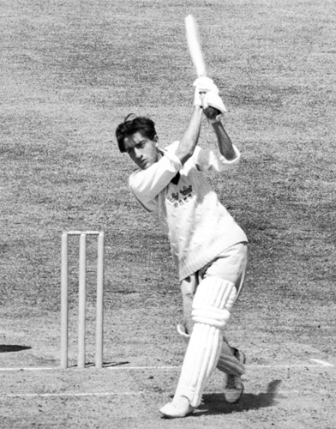
Recap - Problem Statement
What is Video Activity Recognition?
Play

Slide 4
Recap - Approach
Classification based on HoGHoF features
Confidence of Objects using Object Detection
Probabilistic Inference Logic using MLN
Improved Predictions

Slide 5
Recap - Classification using HoGHoF
Describe a video clip as bag-of-features.
Cluster all HoGHoF feature descriptors using k-means.
Represent clip as a histogram over these clusters
Train a classifier
Supervised - Dataset is pre labeled
Output – Average Precisions for each activity

Slide 6
Result – First Stage

Slide 7
Recap - Approach
Classification based on HoGHoF features
Confidence of Objects using Object Detection
Probabilistic Inference Logic using MLN
Improved Predictions

Slide 8
Recap – Object Detection
Using Discriminatively Trained Deformable Part Models
Pre-trained object detector for 19 objects
aeroplane, bicycle, bird, boat, bottle, bus, car, cat, chair, cow, dining table, dog, horse, motorbike, potted plant, sheep, sofa, train, tv monitor
Output – Confidence of object being present in selected frames from the video

Slide 9
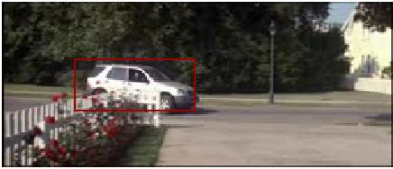
Output of Object Detector
FRAME 1 car -0.181786 . . .

Slide 10
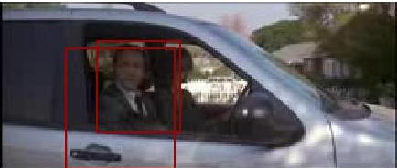
Output of Object Detector
FRAME 1 car -0.181786 . . .
FRAME 151 person 0.579786 person -0.593087

Slide 11
Inference Using First Order Logic
First-order knowledge base (KB) - set of sentences or formulas in first-order logic.
Automated inference using Resolution, by converting clauses to more regular form (CNF/DNF).
First-order KB as a set of hard constraints.

Slide 12


Inference Using Markov Networks
Undirected Graphical models to represent the joint distribution of a set of random variables.
Graph has a node for each variable, and the model has a potential function for each clique in the graph.

Slide 13
Markov Logic Networks
Hard Constraints -> Soft Constraints
MLN :- A set of pairs
:- formula in first-order logic
:- real Valued weight assigned to corresponding formula
Contains binary node for each possible grounding.
Feature for each possible grounding of each formula

Slide 14

Markov Logic Networks
Probability calculated as :-
F : - number of formulas in the MLN.
:- is the number of true groundings.

Slide 15
Example
If many frames have this rule as true then MLN will learn a high weight for this rule.
High weight will lead to high confidence in particular activity.

Slide 16
Winter and This Semester
Done - Object Detection
Under Progress - Markov Logic Network study and implementation.

Slide 17
Current Status
Classification based on HoGHoF features
Probability of Objects using Object Detection
Probabilistic Inference Logic using MLN
Improved Predictions

Slide 18
Finally
Classification based on HoGHoF features
Probability of Objects using Object Detection
Probabilistic Inference Logic using MLN
Improved Predictions

Slide 19
References
Actions in Context by M. Marszalek, I. Laptev and C. Schmid; in Proc. CVPR-2009
Improving Video Activity Recognition using Object Recognition and Text Mining by Tanvi Motwani and Raymond J. Mooney, ECAI-2012
Markov Logic by Pedro Domingos, Parag Singla, et.al., Probabilistic Inductive Logic Programming (pp. 92-117), 2008. New York: Springer.

